Slide 1
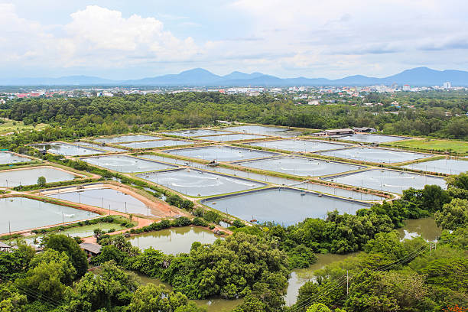
Batch : 17
Machine Learning-Based Aquaculture Water Quality Prediction for Smart Prawn Farming
Project guide:
E. Manemma
Team Members:
Y . Bhavana(23NM1A04H7)
S. Sai Deepthi (23NM1A04D7)
S. Manju sri (23NM1A04E0)
Y. Jahnavi(23NM1A04H6)

Slide 2
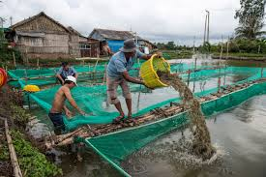
PROBLEM
Maintaining optimal water quality in prawn farming is difficult due to continuous fluctuations in pH, temperature, and turbidity. Traditional manual monitoring methods cannot provide real-time prediction or early warning, leading to disease outbreaks, reduced growth, and economic losses.

Slide 3
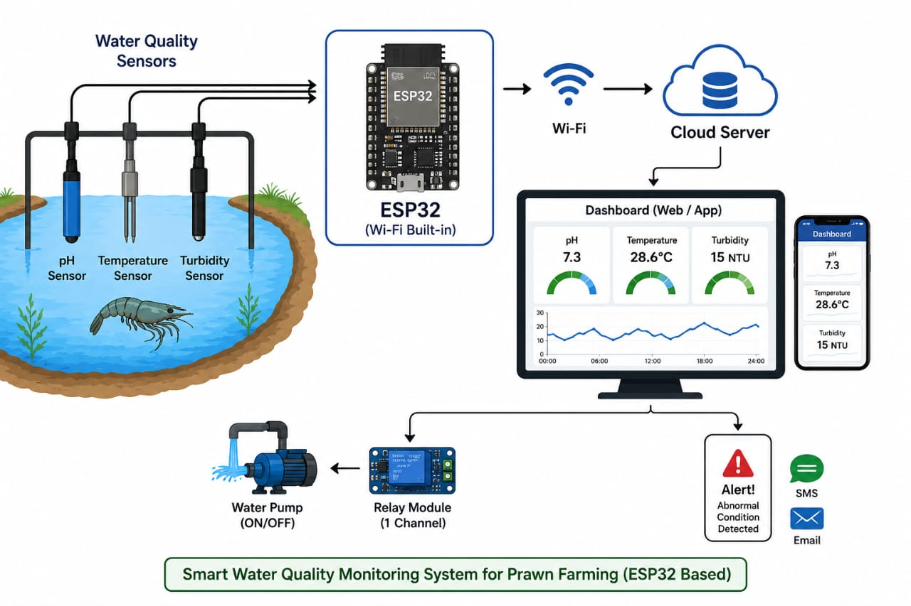
OBJECTIVE
To improve the water quality:
We can continuously monitor water quality parameters such as pH, temperature, and turbidity in prawn farming ponds.
Collect real-time sensor data using an Esp32-based system.
Develop a Machine Learning model that predicts future water quality conditions.
Detect abnormal water conditions at an early stage and generate alerts.
Automate corrective actions such as controlling a water pump through a relay module.
Improve prawn health, survival rate, and farm productivity.
Support sustainable aquaculture practices aligned with SDG 14, SDG 12, and SDG 9.

Slide 4
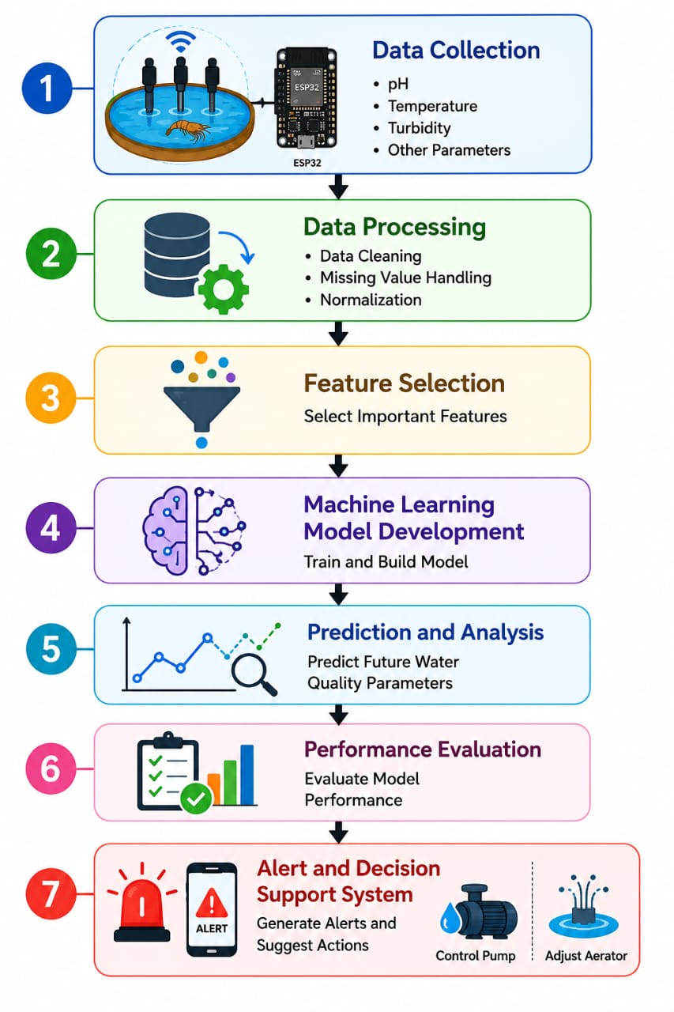
Methodology
Data Collection
Data Processing
Feature Selection
Machine Learning Model Development
Prediction and Analysis
Performance Evaluation
Alert and Decision Support System

Slide 5
IMPLEMENTATION
HARDWARE IMPLEMENTATION:
Esp32
pH sensor
Temperature Sensor
Turbidity Sensor
Relay Module
Water Pump
Power supply
Breadboard and Connecting Wires
SOFTWARE IMPLEMENTATION:
Esp32 for sensor interfacing and data acquisition.
Python for data preprocessing, Machine Learning model training, and prediction.
Machine Learning algorithms such as Decision Tree, Random Forest, or Linear Regression for water quality prediction.

Slide 6
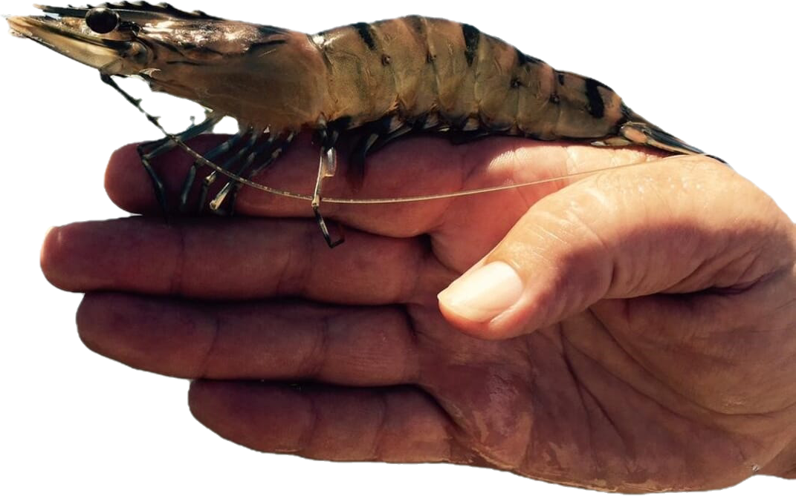
OUTCOME
The proposed system enables real-time monitoring and prediction of water quality in prawn farms, provides early alerts for unsafe conditions, automates corrective actions, reduces prawn mortality, improves productivity, and supports sustainable aquaculture practices.

Slide 7


